Slide 1


Consumer Complaints
Group members: Jana Khamis, King Yuet Lau, and Paul Schaefer

Slide 2
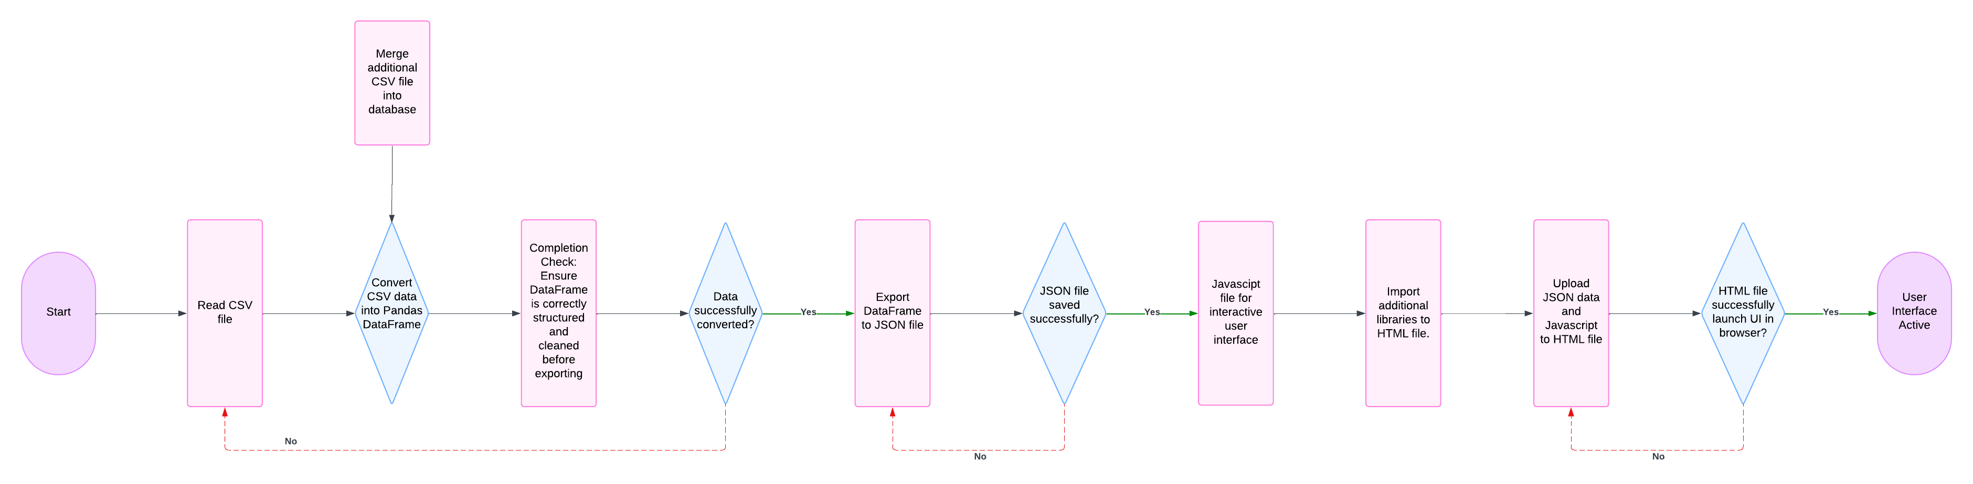

Slide 3
2024

Slide 4

Dropped columns and NAN.
Changed data types.
Combined similar values.
Merged Dataframes.

Slide 5
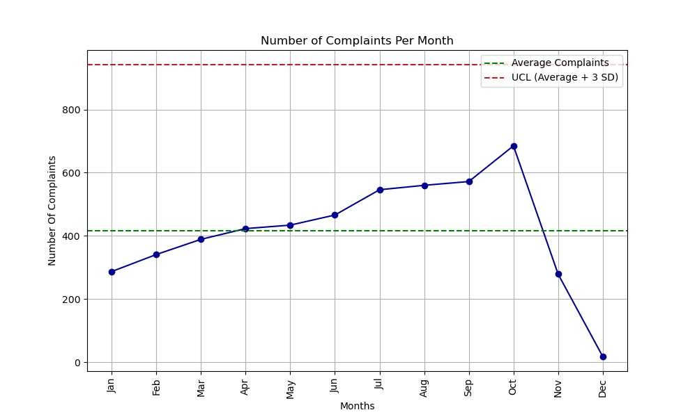
How are Complaints Dispersed Across the Calendar Year 2024?

Slide 6
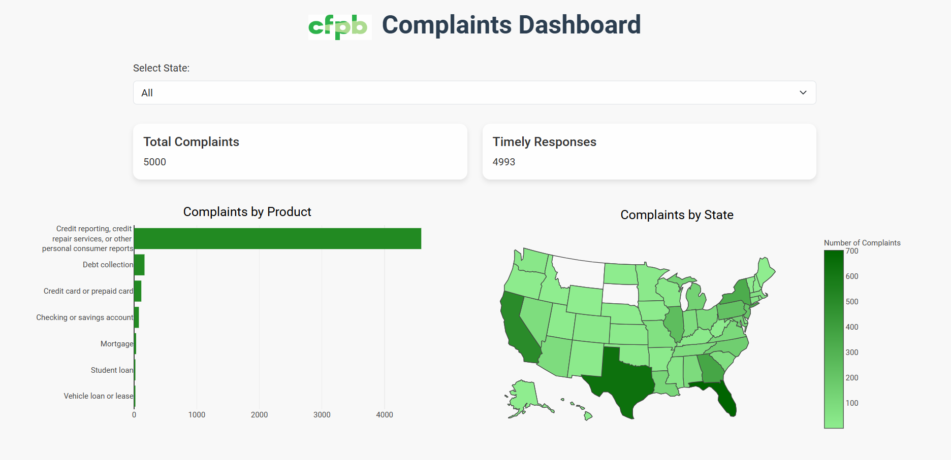
Webpage
Leaflet.js, Plotly.js, Bootstrap, and Google Fonts.
Drop down bar for navigation.
Map breaks down data by state.
Bar graph breaks down data by product.

Slide 7
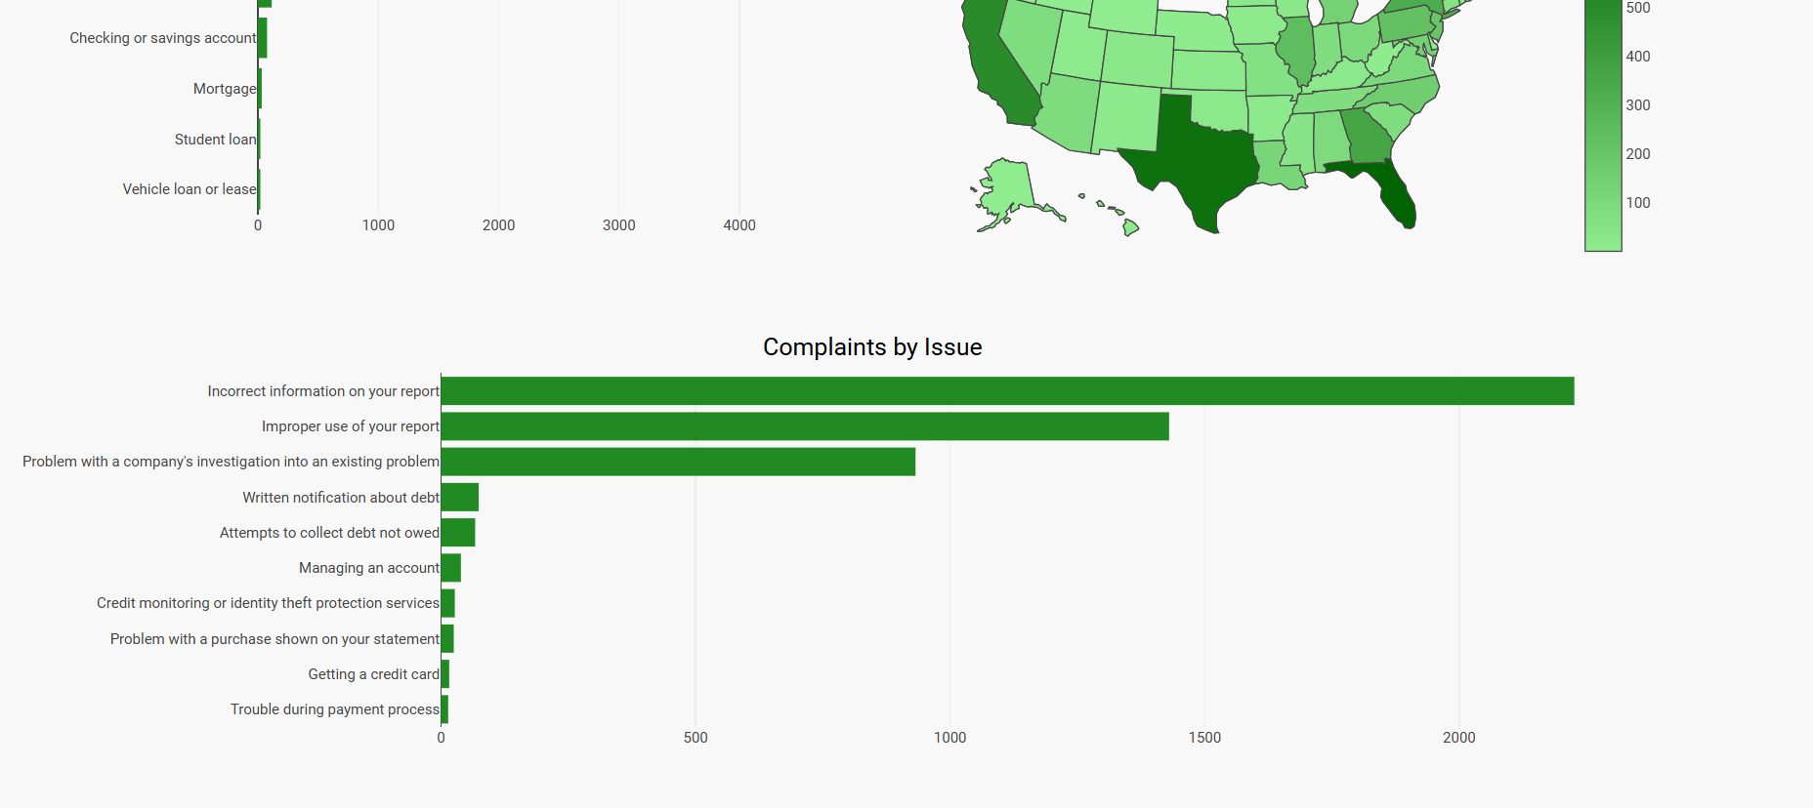
What are the most common issues?

Slide 8
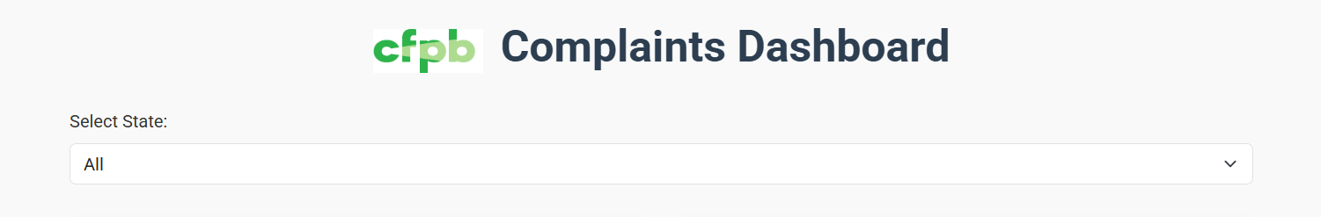
IniT Function

Slide 9
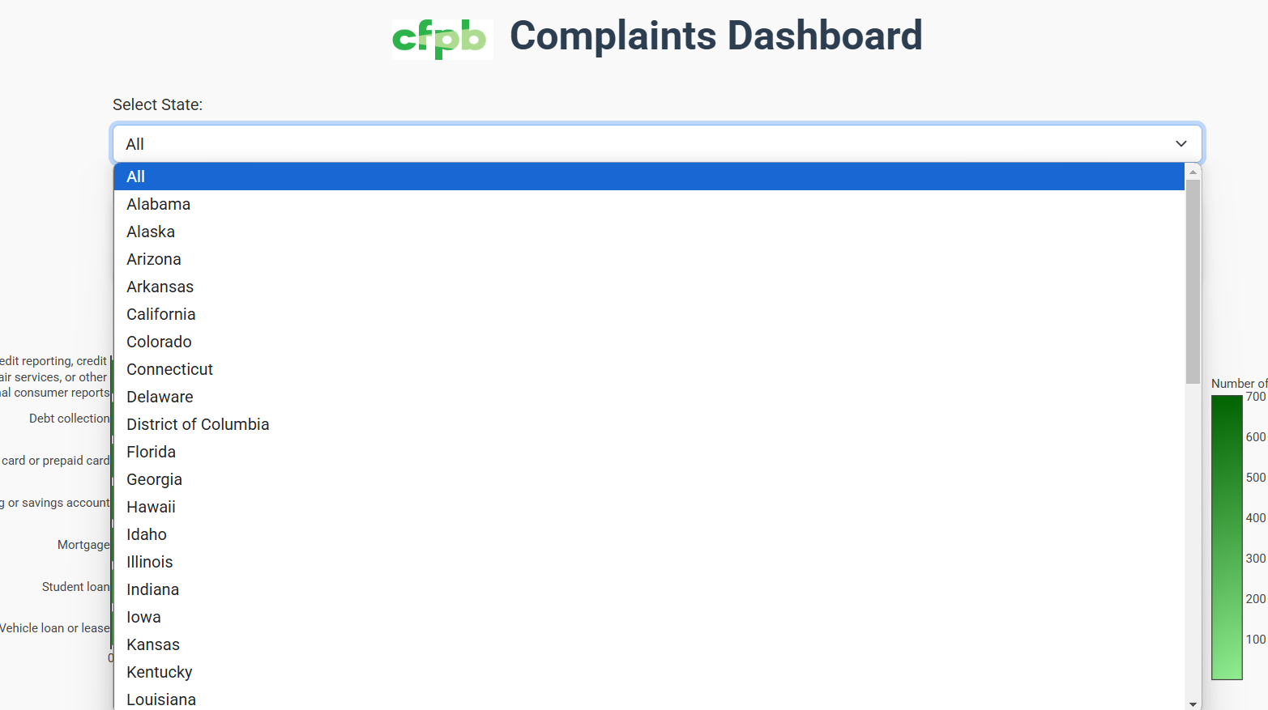
stateDropdown Function

Slide 10
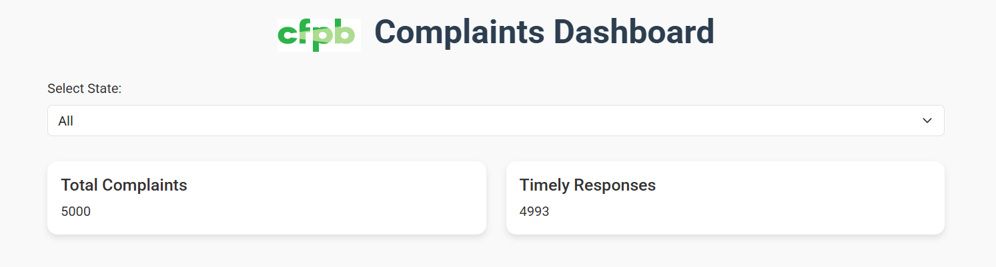
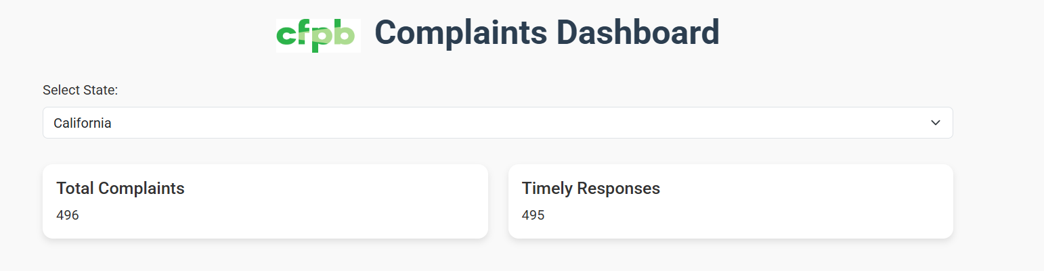
Buildsummary function

Slide 11
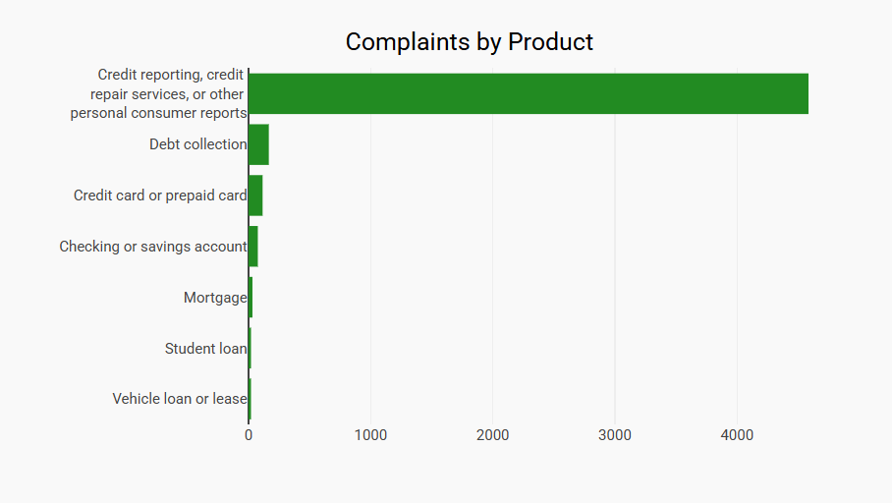
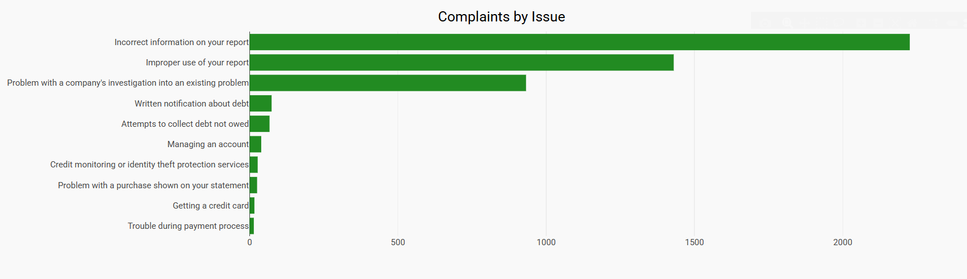
Buildcharts Function

Slide 12
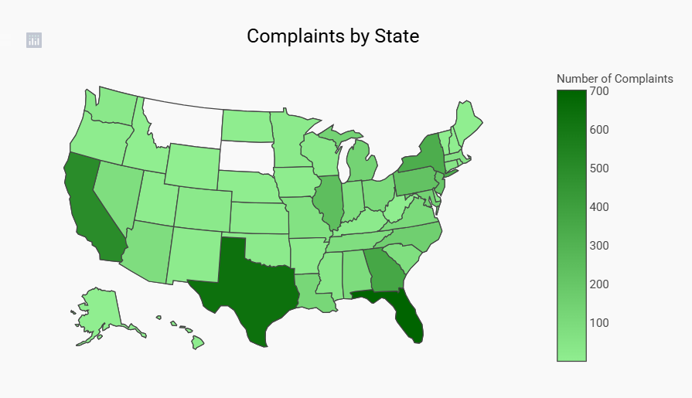
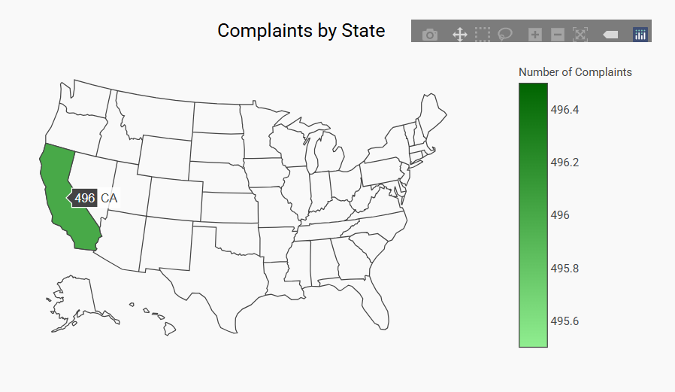
Buildmap function

Slide 13
https://janettelau.github.io/consumer_complaints/

Slide 14
Thank You

